Slide 1




Isolating systematic effects with beam polarisation at e+e− colliders
17.03.2021
LCWS 2021
Notes:
- Global interpretations are rapidly gaining attention
- In addition to their physics advantages, this combined fits may also help us understand systematic effects better, especially when combined with beam polarisation

Slide 2
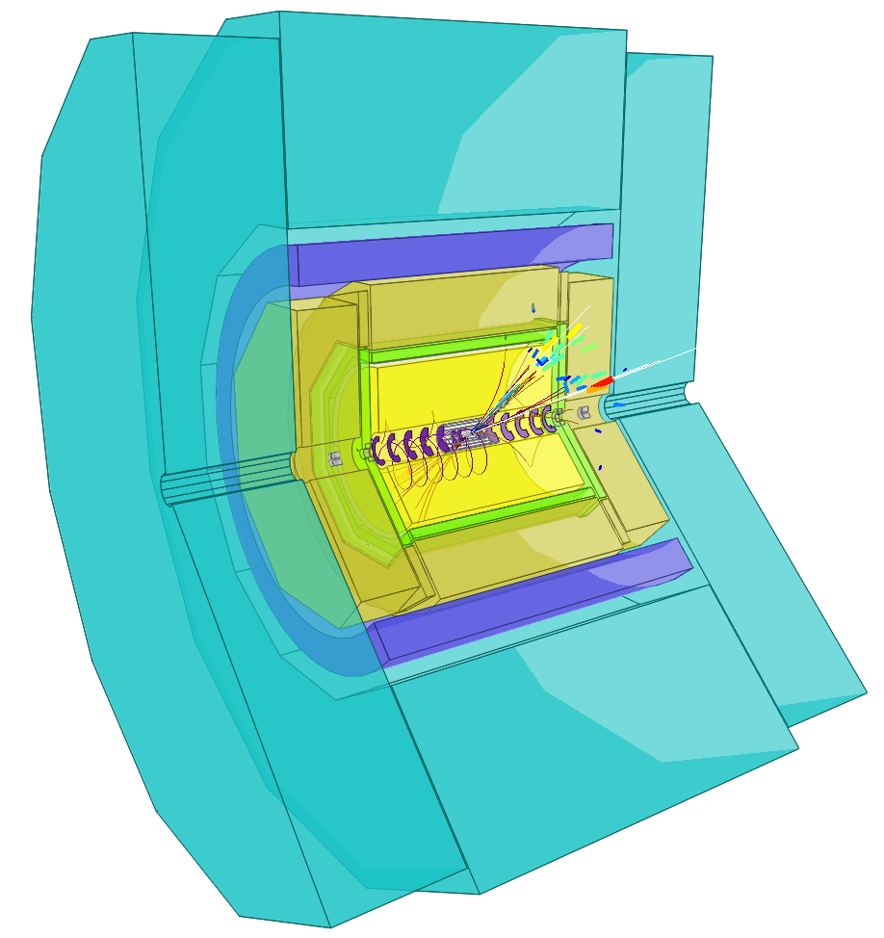
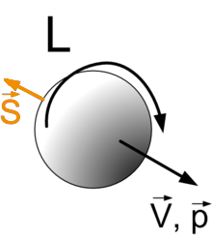
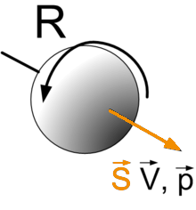
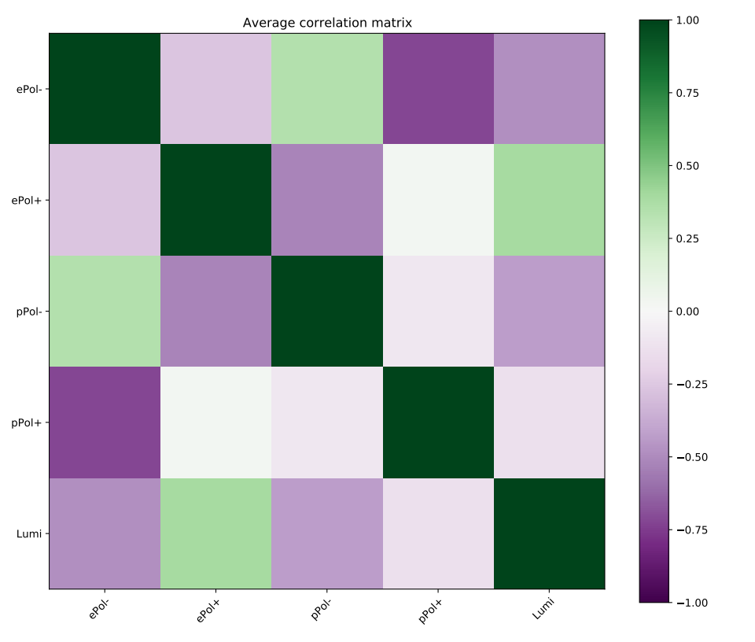
Beam polarisation & systematic effects
Framework for combined fit
Systematic effect in fit: μ acceptance
?
Notes:
- Brief introduction into how BP may help with systematic
- Then how I started to build the foundation for testing it

Slide 3
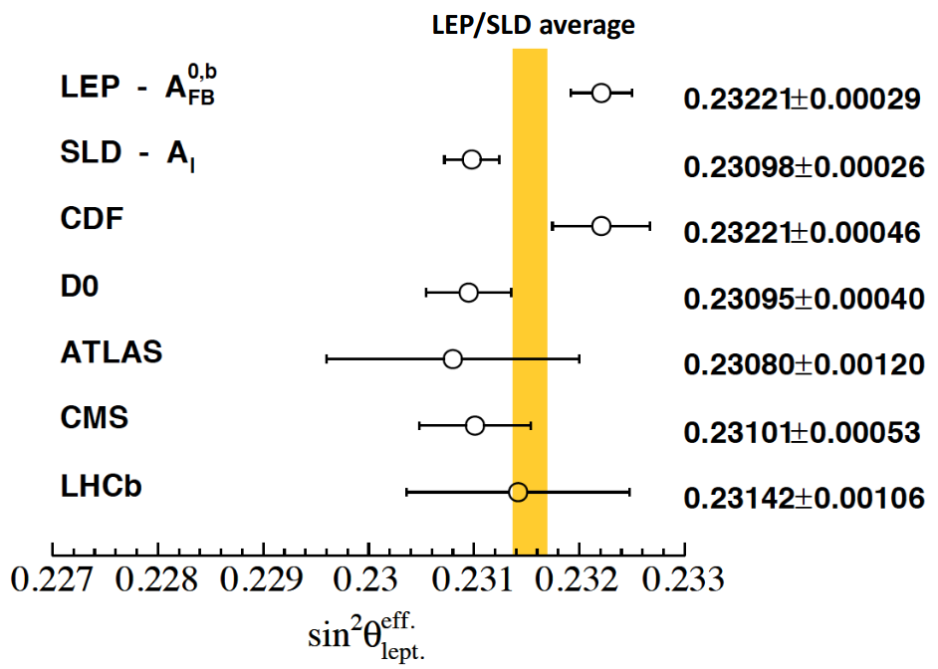
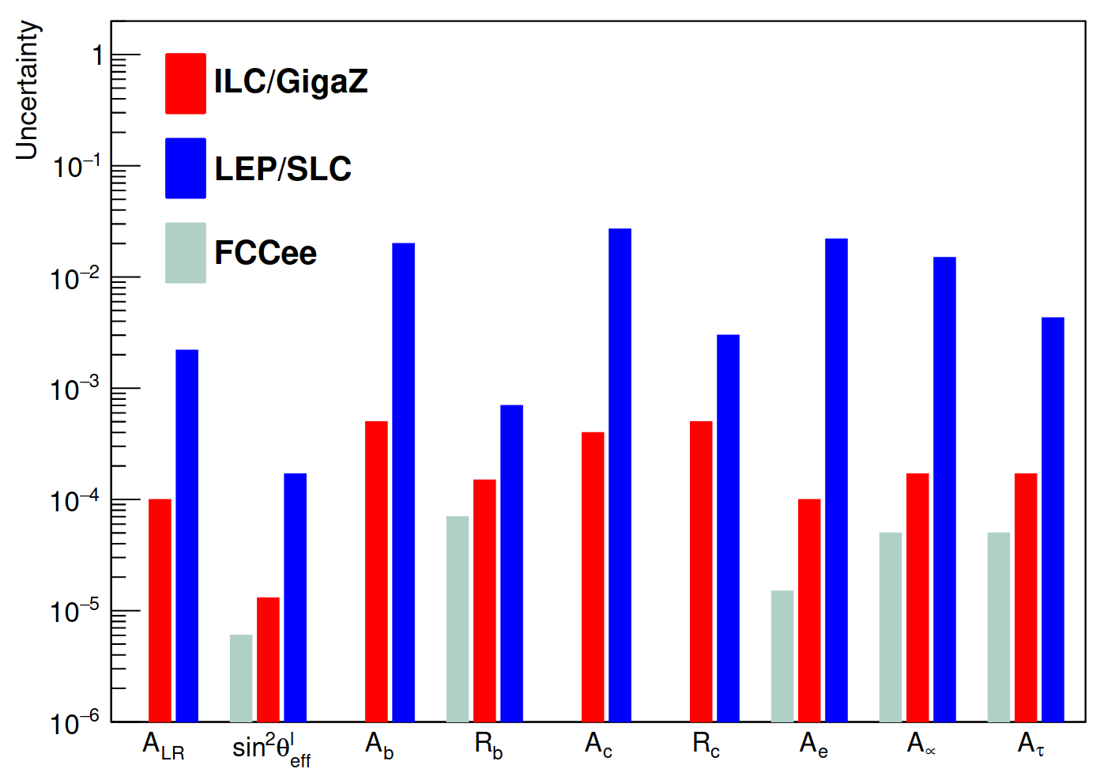
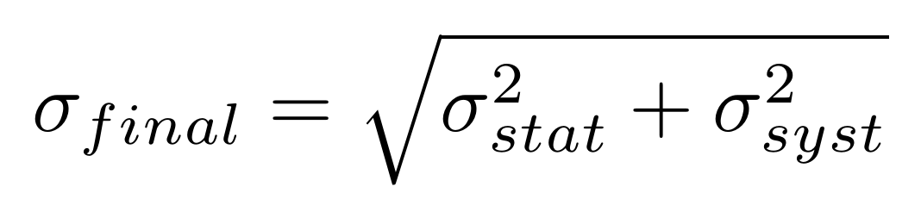
Impact of beam polarisation
Physics ✓
Systematics ?
[William J. Barter]
?
So far:
[arXiv:1908.11299]
External estimation
Notes:
- Historically understand physics advantage of BP
- Has also been shown from studies at future colliders
- Essentially unstudied so far: effect on systematic uncertainties
- So far: stat unc from MC study, unc from main systematic effects externaly estimated, than added in quadrature
- Neglects a profound influence of BP on systematic effects

Slide 4


Flipped
–
+
–
+
Polarisation
Different
Physics
Same
Detector
Systematic effects will have
uniquely global signatures if
included in combined fit!
Notes:
- Collider w/ pol has polarised datasets with flipped polarisation signs
- Flipped BP means changed physics
- Detector effects will be the same (uniquely global)!
→ Hypothesis: If directly included in measurement as an effect, can be separated and won’t contribute to uncertainty.
- For this to work, we need to change how we treat systematic effects

Slide 5
External estimation
New
approach
Polarised
datasets
Combined fit
Final states
Hypothesis
Disentangle systematic from physical
effects by fitting them simultaneously!
Notes:
- Need to move away from external estimation of systematic uncertainty
- Instead, directly include systematic effects in fits
- In fits: combine the different polarised datasets, and final states with the same systematic effects
- The hypothesis being that we can disentangle systematic from physical effects by fittin ghtem simultaneously
- This has not been tested before

Slide 6
Beam polarisation & systematic effects
Framework for combined fit
Systematic effect in fit: μ acceptance
?
Notes:
- Aiming to test fitting systematics in combined fit
- First step: framework for combined fit in different collider scenarios

Slide 7
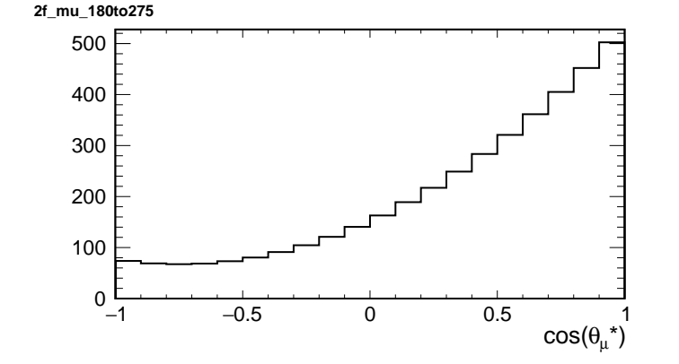
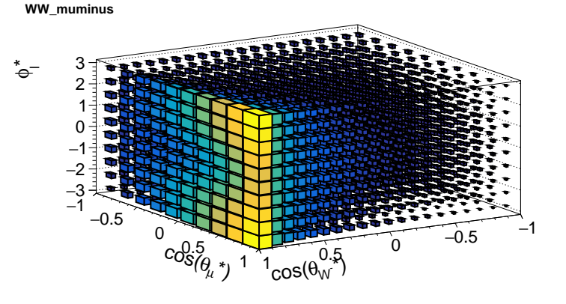
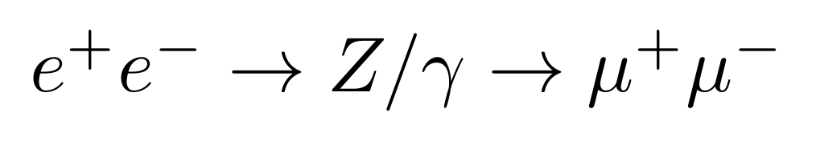
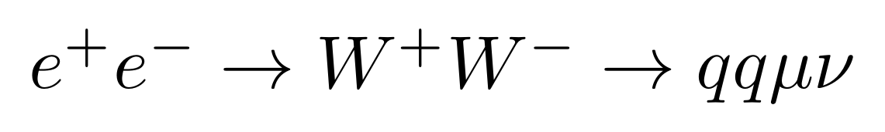
return-to-Z separately from high-Q²
μ⁺ and μ⁻ separatey
Polarised distributions
Toy fluctuated distributions
Combined Fit: Log-Likelihood maximisation
Notes:
Setting up such a combined fit
- Fitting simultaneously different polarised datasets, as well as different processes which are affected by the same systematic effect
- Focus here: mu systematics → mumu, WW semilep
- So far all on particle/MC level
- distributions: dimuon (separated…) 1D, W pair semilep (separated…) 3D
- weighted to the corresponding polarisations
- “toy measurement” : Poisson fluctuating this
- Those toy measurements I can test my fit on
- Log-likelihood fit to differential distributions
- The polarisation weighting depends on the scenario

Slide 8
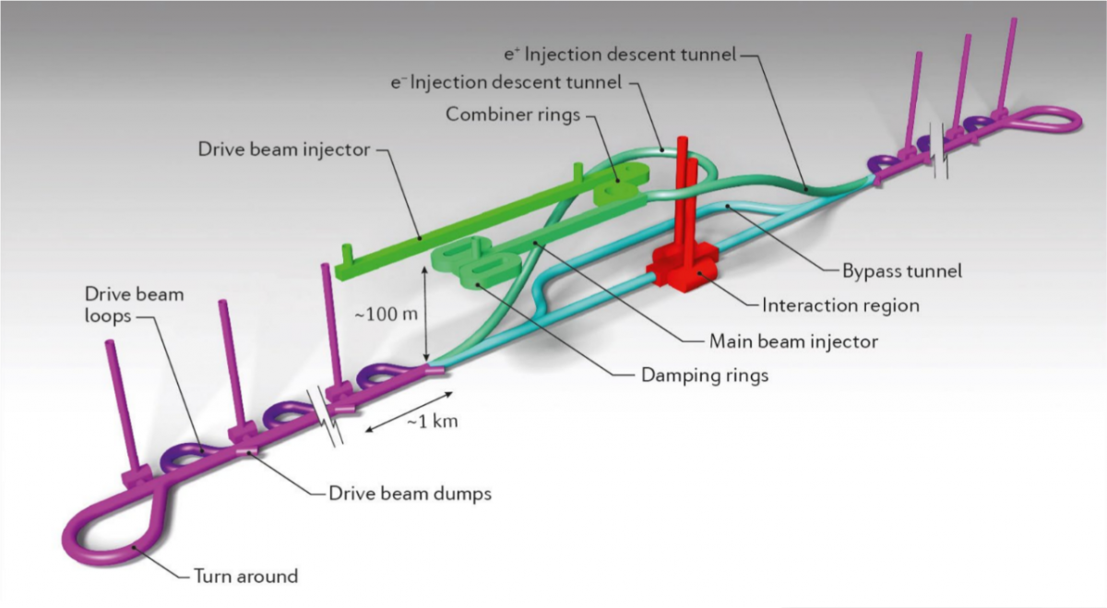
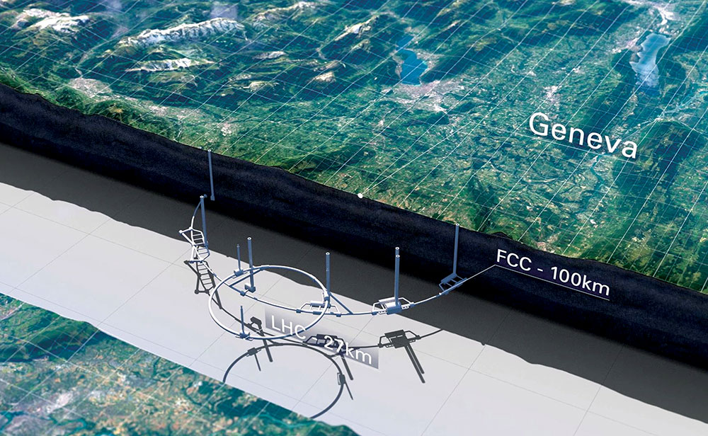
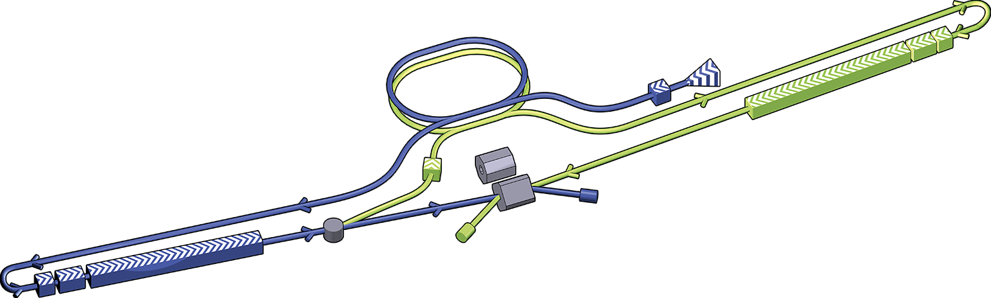
250GeV test scenarios
Pol.: (80%,30%) (80%,0%) (0%,0%)
Sharing: +- : -+ : ++ : -- +0 : -0 00
45 : 45 : 5 : 5 50 : 50
L: 2ab⁻¹ , 10ab⁻¹
Constraints: ΔL/L = 3e-3, ΔP/P = 2.5e-3 (= ΔP₀)
[arXiv:1304.4082]
[arXiv:0902.3221]
Notes:
- Three polarisation scenarios motivated by three tips of proposed colliders
- Two luminosities
- Realistic polarimeter (bhabha scattering) and lumimeter constraints (1e-3)
- Simple first demonstration of framework just fits Lumi and Polarisation to differential distributions

Slide 9
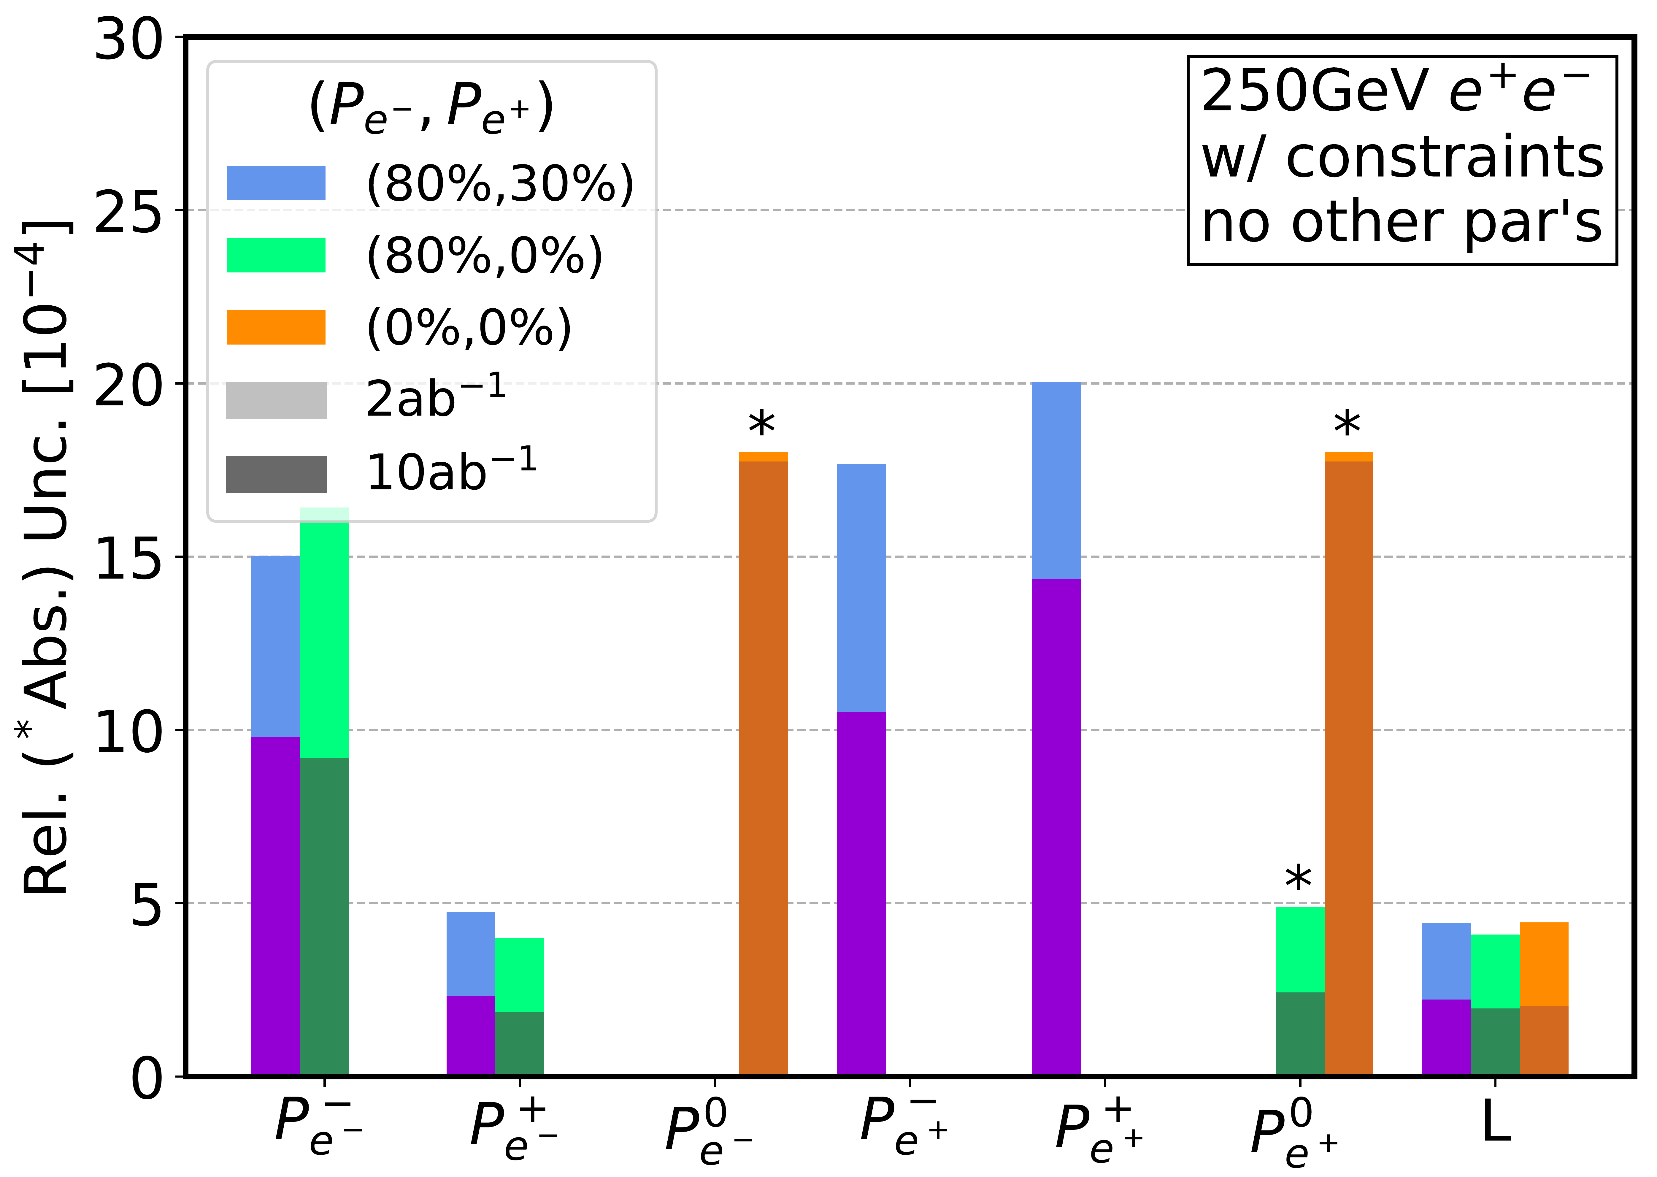
Can test P-&L-dependence of uncertainties
Purely for testing!
- no other parameters
- cross sections fixed
Notes:
- Results for uncertainties of Pol. & Lumi. fitted in combined fit to mumu & WW
- Will not pay to much attention to exact results here, very preliminary and does not include any physics at all
- All chiral cross sections are fixed
- Can see that higher lumi generally brings better precision
- In addition to uncertainties I also get parameter correlations

Slide 10
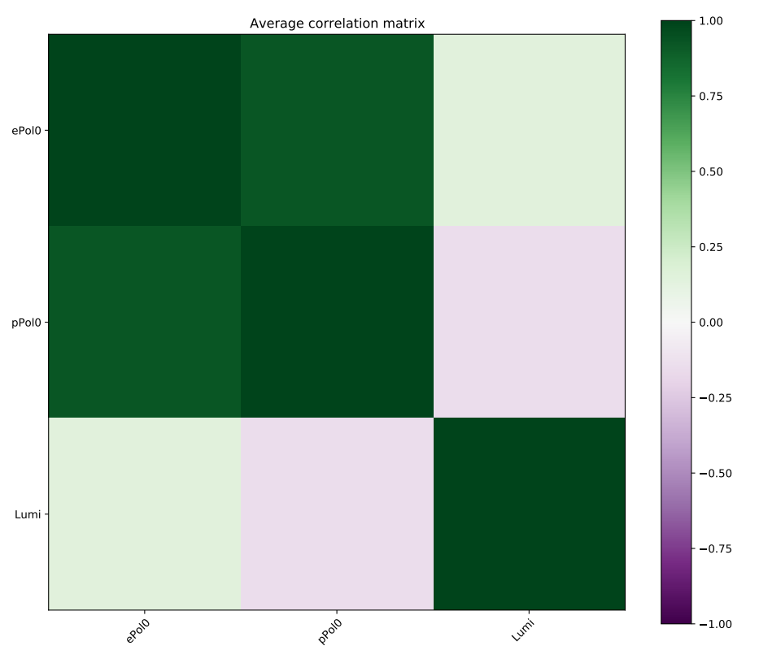
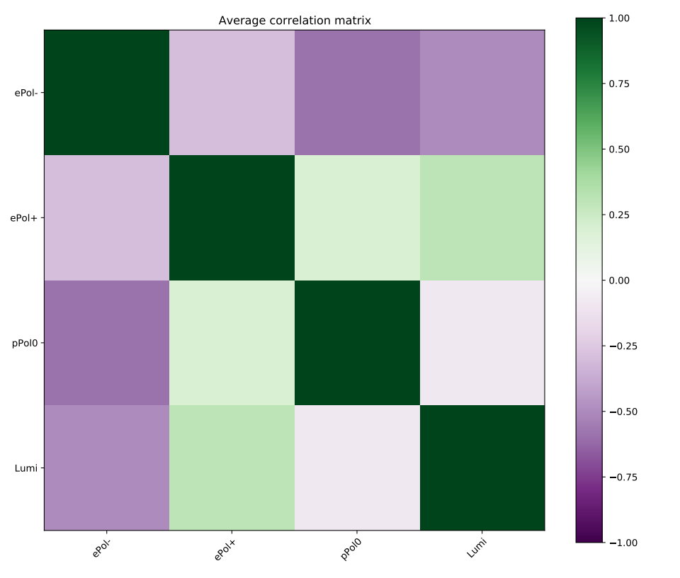
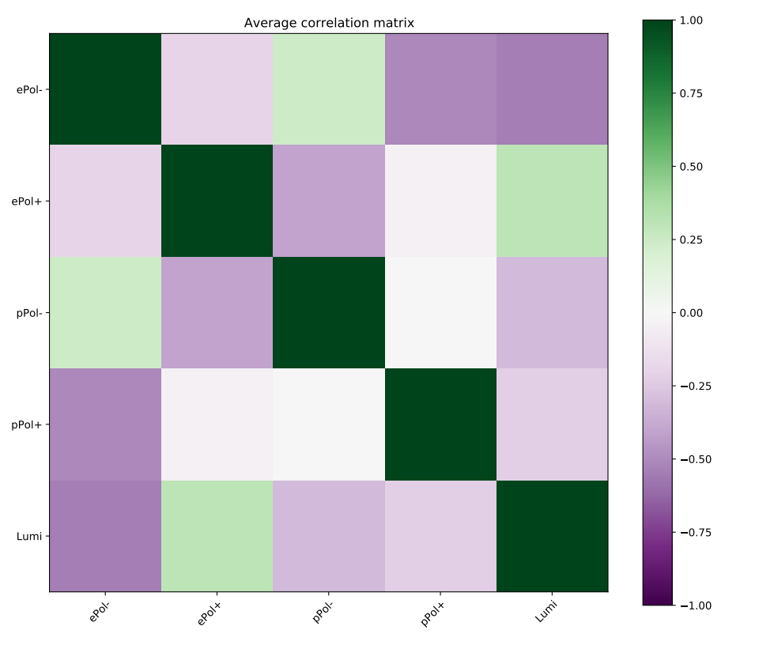
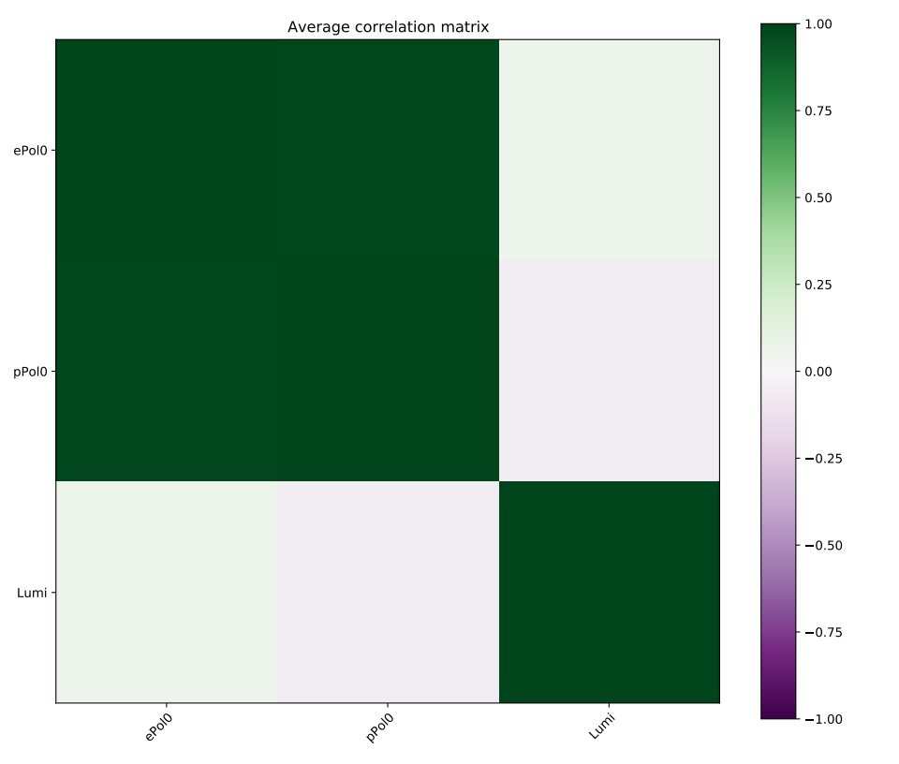
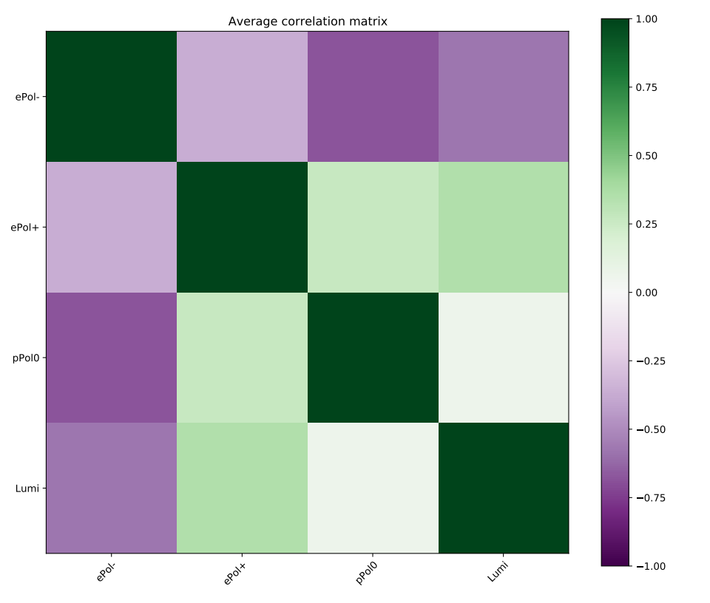
(0%,0%)
(80%,0%)
(80%,30%)
2ab⁻¹
10ab⁻¹
Can test P-&L-dependence of correlations
Notes:
- Plots show correlation between fit parameters (here: Lumi and Pols) for different P&L scenarios
- Again not paying lots of attention to the results here
- Important message: Got framework running that can test the dependence of uncertainties and correlations on the collider scenario
- Can start to think about using it to test influence of scenario on systematic effects and uncertainties

Slide 11
Beam polarisation & systematic effects
Framework for combined fit
Systematic effect in fit: μ acceptance
?
Notes:
- With framework at hand: First attempt to implement an actual systematic effect in a combined fit: mu acceptance
- Will need to do 3 things: choose a shape implementation of effect, choose a parametrisation in the fit, validate the parametrisation

Slide 12
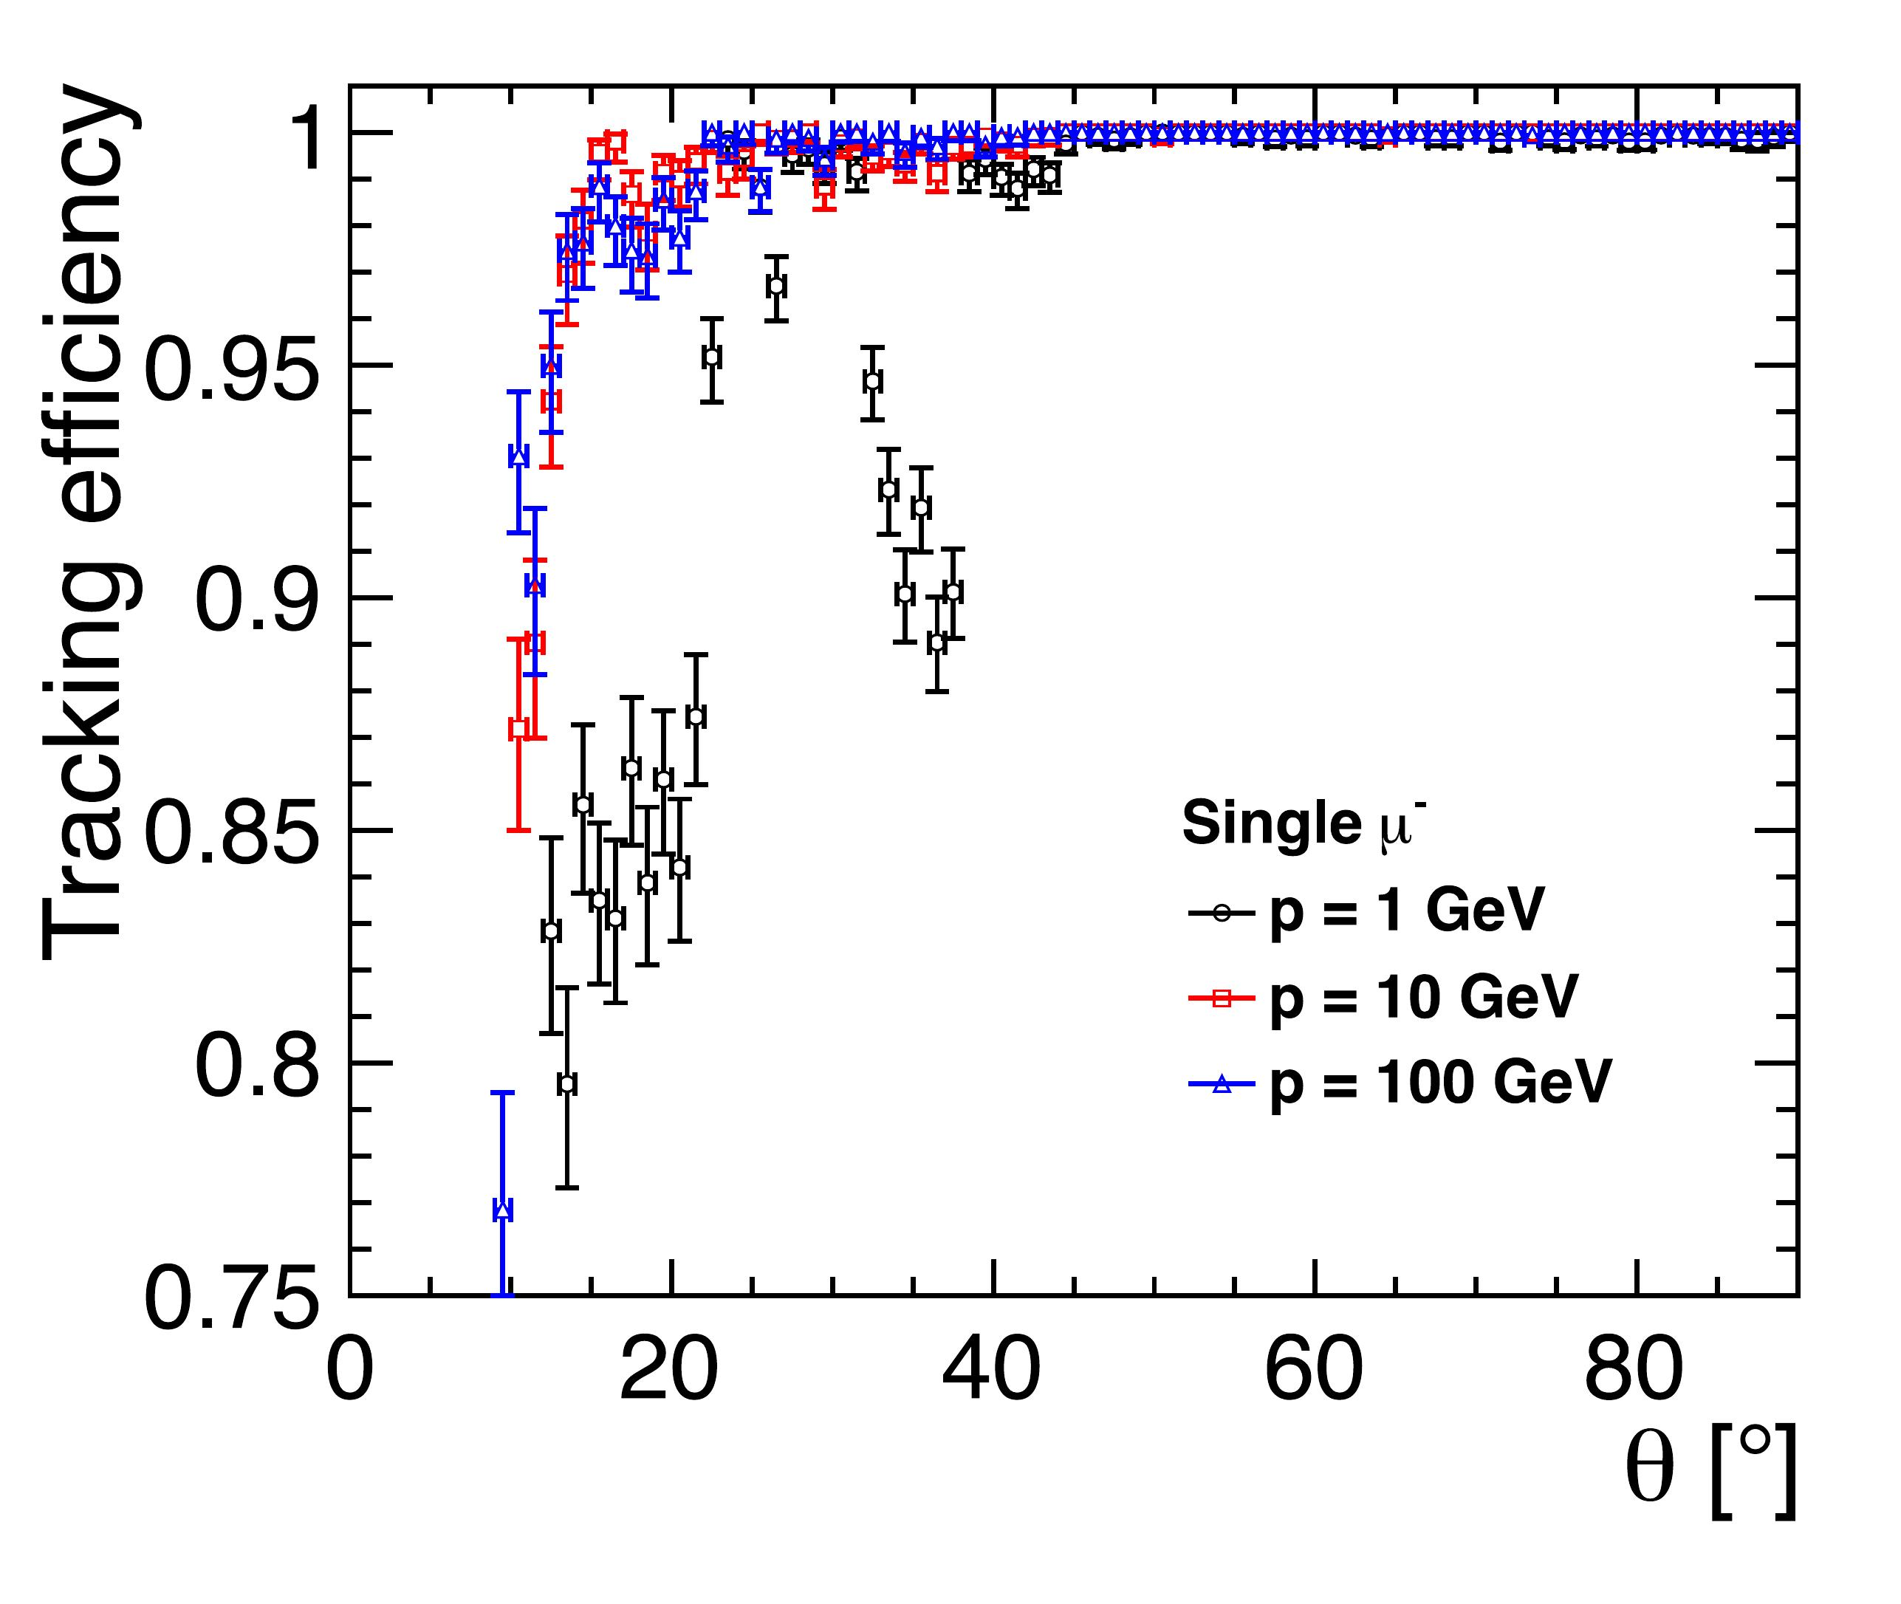
Implementing μ acceptance
Simplified picture:
Event passes if all μ’s inside box
width w
center
c
SiD @ ILC
7º
7º
cos(θ)
-1
0
1
-1
[ILC TDR – Volume 4]
Fit parameters: Δc, Δw
Notes:
- First need to choose systematic effect: Here mu acceptance (simple one)
- Left shows single mu acc for realistic future detector simulation
- Starting of easy: simplified model where event passes if all muon are inside acceptance box
- box has two parameters: center and width
- The combined fit is supposed to extract the deviations of the center and width of the acceptance
- For this, I need to parametrise the effect of these parameters on each bin of the fitted distributions

Slide 13
Parametrising μ acceptance
width w
center
c
Effect on
?
7º
7º
cos(θ)
-1
0
1
-1
Parametrisation (per bin):
dσ/σ = k0 + kc Δc + kw Δw + kc2 Δc² + kw2 Δw² + kcw Δc Δw
...
Test (c±δ,w±δ) values on MC
Notes:
- Choosing here to parametrise the influence of dc and dw on each bin with a second order polynomial
- Need to determine the coefficients of the polynomial:
- apply some varied cuts on the Monte Carlo
- Check how bin content changes with variations and determining coefficients
- Lastly need to validate that this parametrisation accurately represents the effect

Slide 14
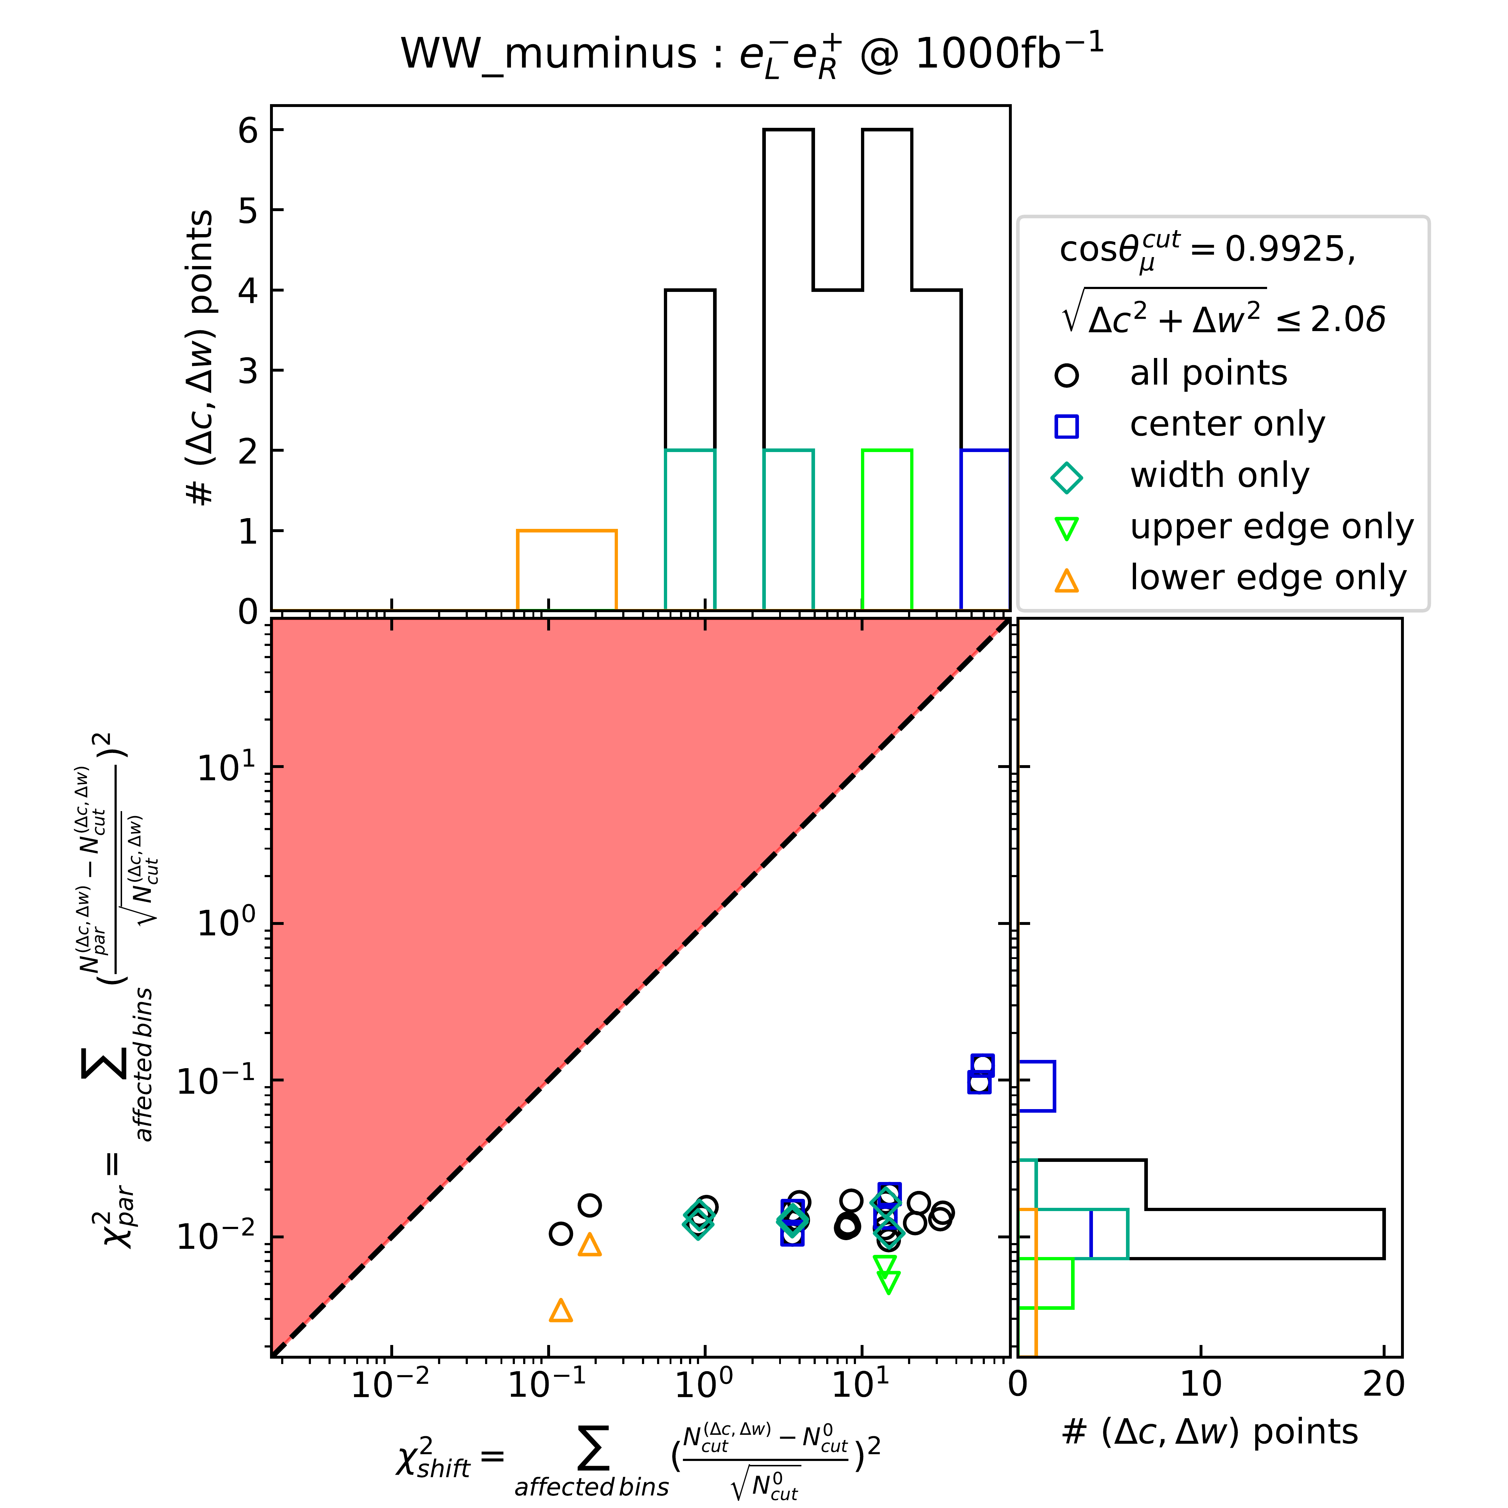
Validation of the
parametrisation:
δ = 2e-4
How relevant is:
- mistake made by
parametrisation
vs.
- effect of deviation ?
Safe to use✓
Notes:
- Tricky question: How can I tell that differences between actually apply the acceptance and applying the parametrisation aren’t relevant?
- Demonstrating here for eLpR WW muminus
- Comparing the chi^2 that the variation of the parameters produces with chi^2 of the mistake made by parametrisation
- testing many different center and width shifts
- Red zone mean mistake more relevant than actual effect
- Repeated for all chiral distributions
- Nothing in red zone, parametrisation is safe to use
- Can apply this in fits!

Slide 15
First tests:
Statistical influence
of collider setups
Purely for testing!
- else only: L,P’s
- cross sections fixed
Notes:
Testing collider setups
- Both polarised, e- pol, no pol
- 10ab-1, 2ab-2
Showing uncertainties on mu acc parameters
- Precision of O(10^-5) (in costheta)
Seeing the influence of different statistics in the different scenarios
- Lumi different factor sqrt(5)
- Pol difference due to splitting of datasets (more lumi to dataset with higher cross section)
- Can’t say anything about influence of measurement precisions yet, no physical effects included that could correlate
- Again can look at correlations

Slide 16
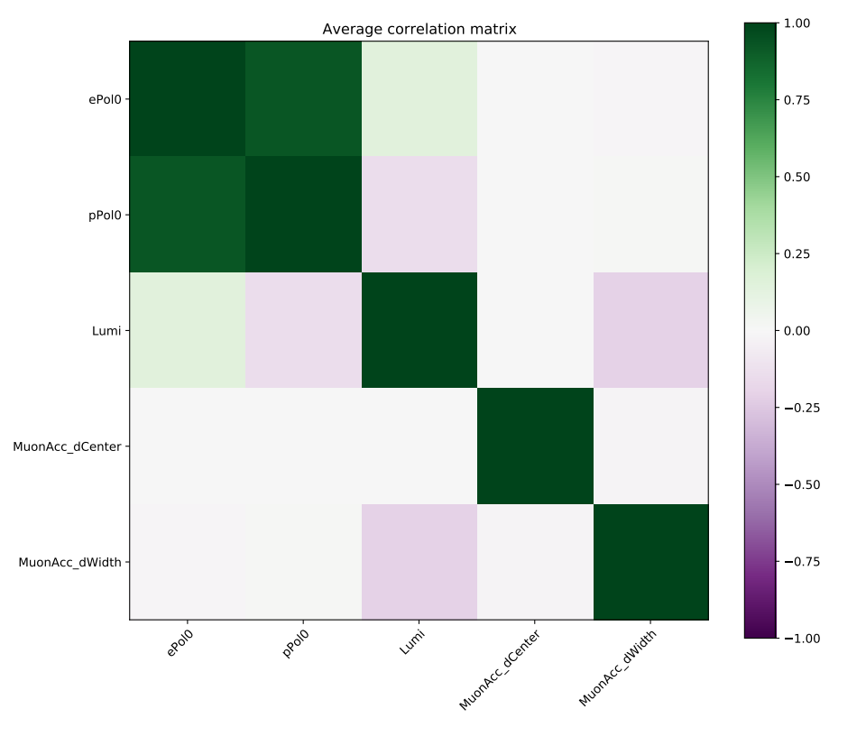
Example:
2ab⁻¹ unpolarised
Free parameters:
Polarisations & Lumi
(w/ constraints)
μ acceptance
parameters
accept. width & lumi anticorrelated
Notes:
Example where I perform a fit for the scenario of unpolarised beams and 2ab-1
- Fitting the muon acceptance parameters together with the polarisation and luminosity
- Polarisation and Luminosity have realistic constraints O(10^-3)
- center doesn’t correlate with anything
- width slightly anitcorrelates with Lumi (more – less events on both sides)
- And can do this again for all different scenarios

Slide 17
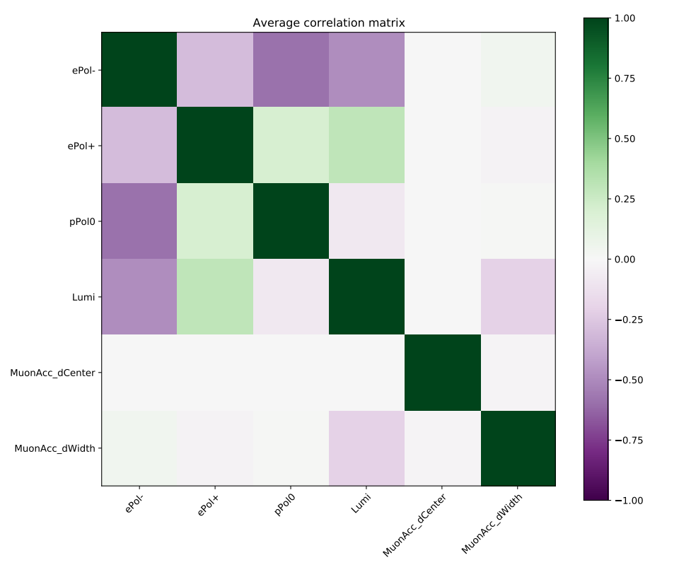
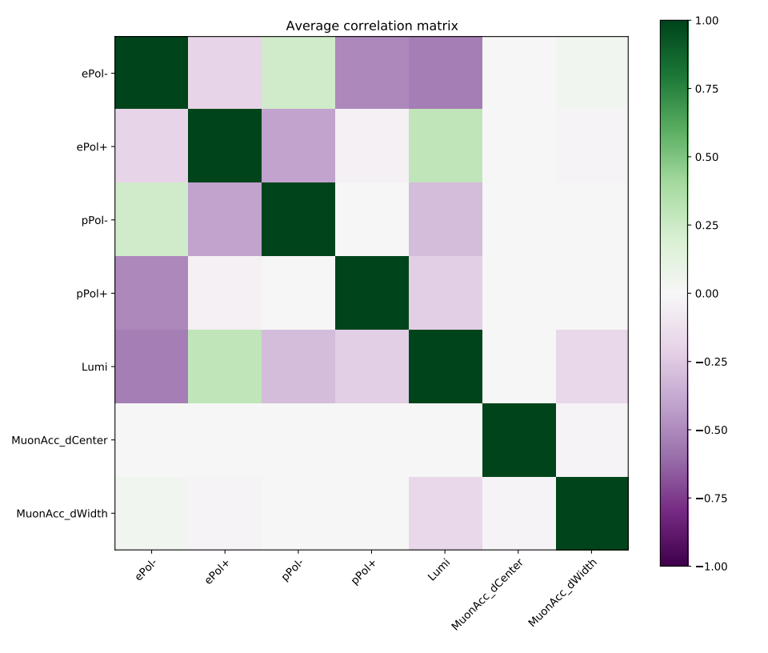
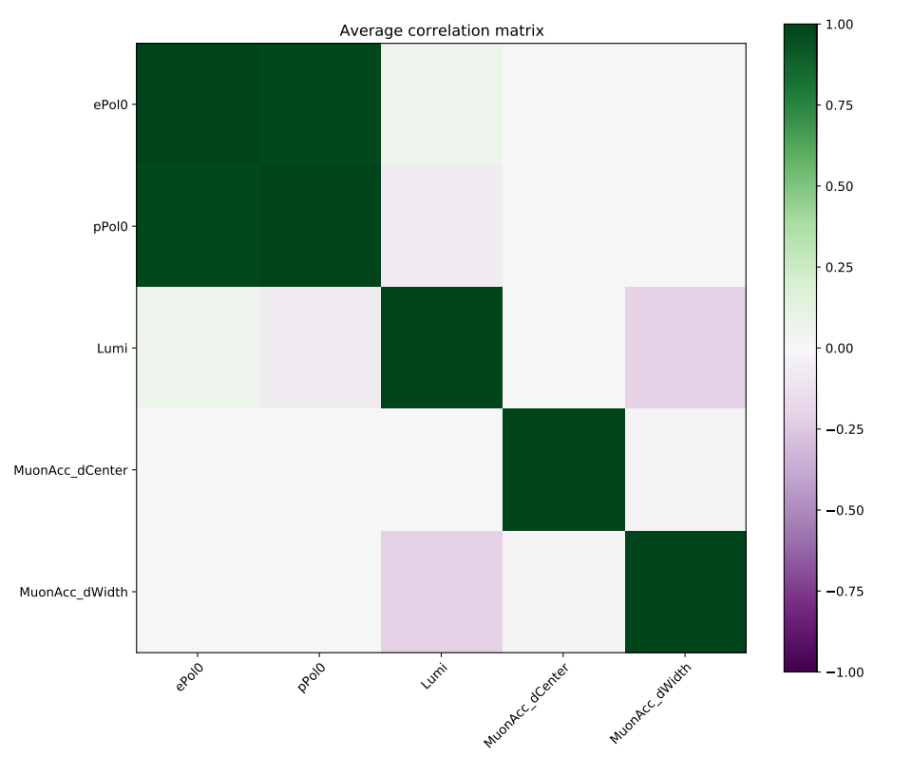
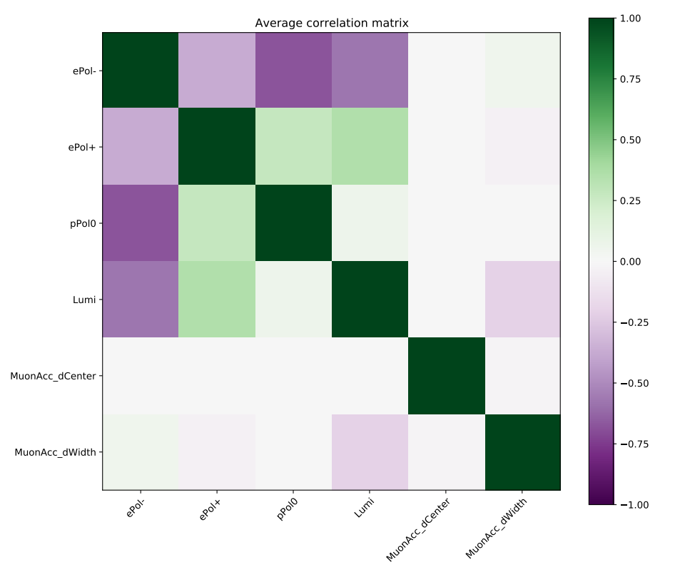
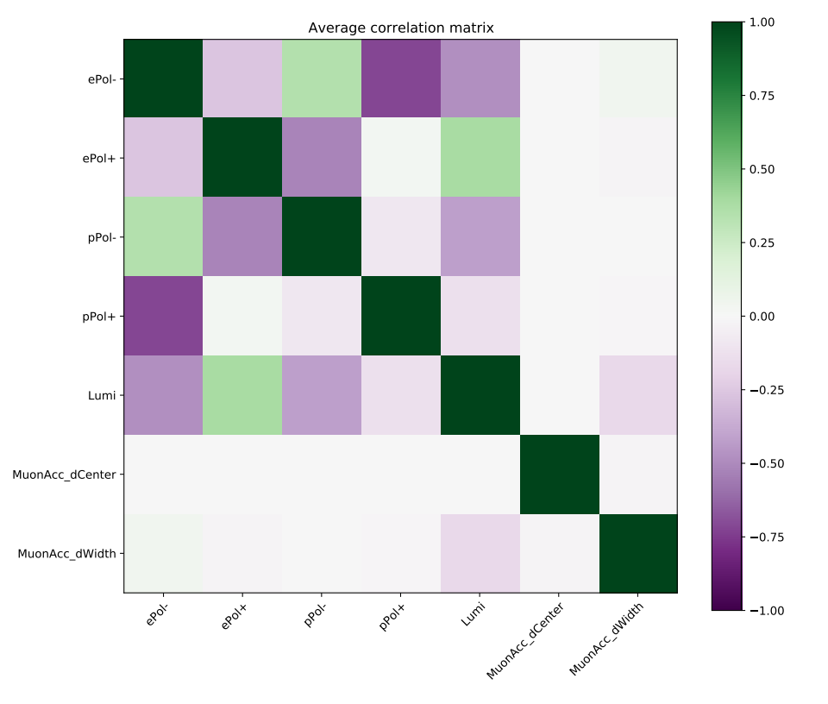
(0%,0%)
(80%,0%)
(80%,30%)
2ab⁻¹
10ab⁻¹
Systematic effect alone unaffected by polarisation
Notes:
- Focus on lower two lines: systematic effect
- No change between all of the scenarios
- Reiterate: There is no physics effect that changes differential distributions, only difference is statistics
- Correlation does not depend on statistics, so alone it is unaffected by the systematic
- Systematic implementation works as expected
- Next will be implementation of physics to see what difference polarisation makes

Slide 18
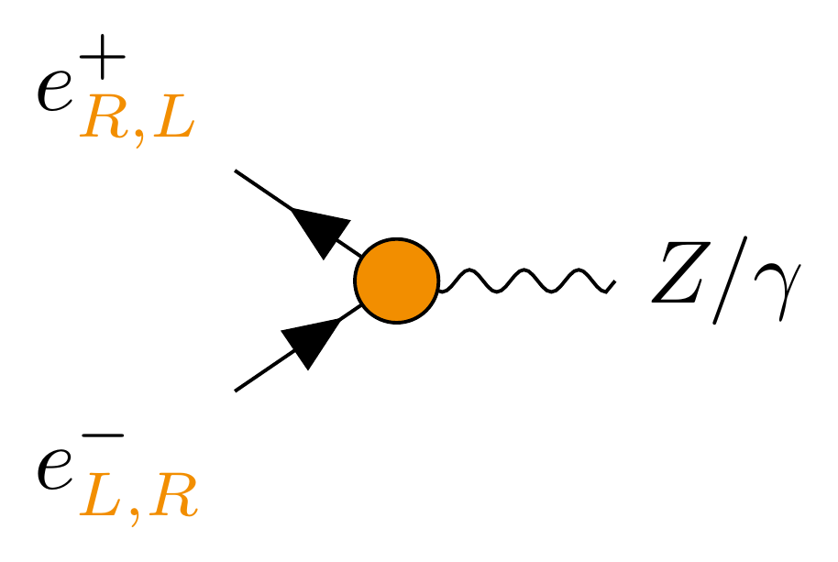
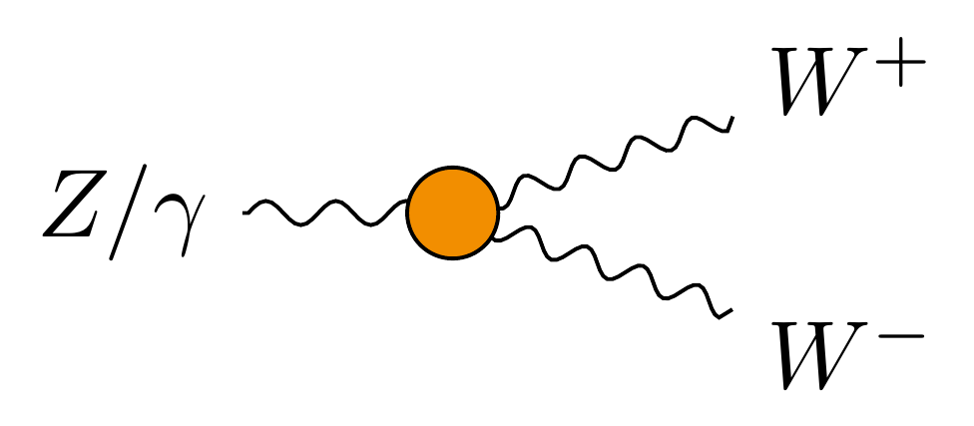
Next step: physical effects
Correlation
Physics – Systematics
?
Chiral fermion
couplings
Dependence on
Polarisation & Lumi
?
Triple Gauge
Couplings
Notes:
Plan: add physical effects that influence differential distributions and potentially correlate with mu acceptance
- See if they correlate
- Are correlations and uncertainties dependent on available polarisations?
- There is quite some work left here, and not just for me

Slide 19
Impact of beam polarisation:
  Physics ✓
  Systematics ?
?
Your analysis?
The full impact of beam polarisation has yet to be determined and could significantly change the achieved precisions.
Notes:
Full extent of advantages hasn’t been explored
→ Known to bring physics advantages
→ Only started to test if also systematic advantages
- While I keep working on this first test, I would like to encourage you to think about your analysis
- Are there systematic limits to it? And could beam polarisation isolate them?
Important consideration for future colliders

Slide 20
Beam polarisation hypothesised to help
separate physical and systematic effects
Set up framework for combined fit
Implemented first systematic:
μ acceptance
Next: implement physics to test hypothesis
?

Slide 21
BACKUP

Slide 22
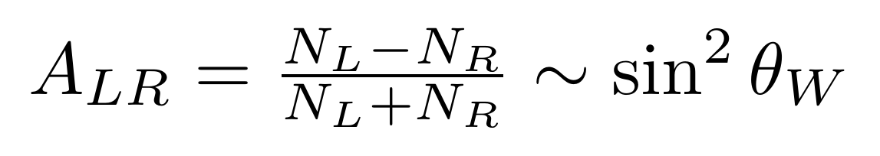
N_{L}
N_{R}
e⁺e⁻
~ 300 x more events
e⁻ polarisation
pp
[William J. Barter]
Notes:
SLD as polarised collider had two dataset: e-L dominant and e-R dominant
- Allowed for use of left-right asymm which directly accesses free parameter of SM
- Not available at unpol. Colliders (more difficult)
Plot (2018) shows uncertainties on Weinberg angle for different collider experiments
- much harder at pp (even modern) than at ee
- comparing ee:
→ comparable precision of LEP and SLC
→ LEP with 300x more events
→ SLC with easy access to Weinberg angle through asymmetry
- Beam polarisation made up for 300x less lumi!

Slide 23
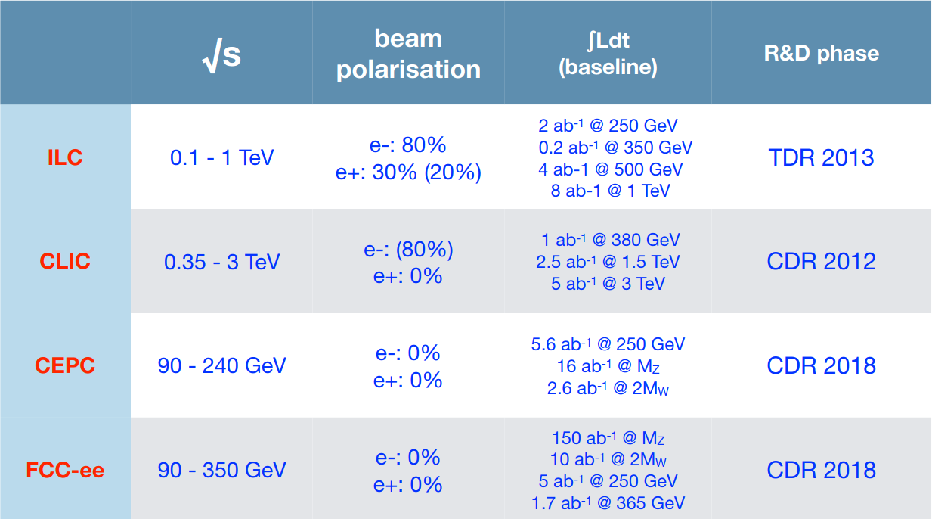

Slide 24
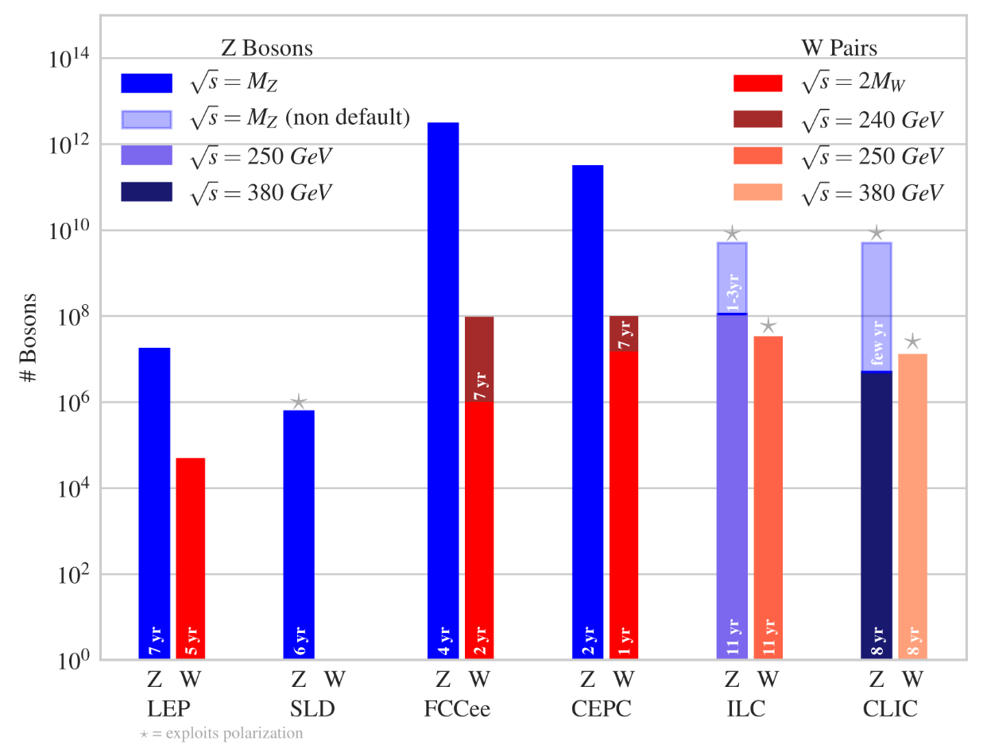
[EPPSU20 Physics Briefing Book]

Slide 25
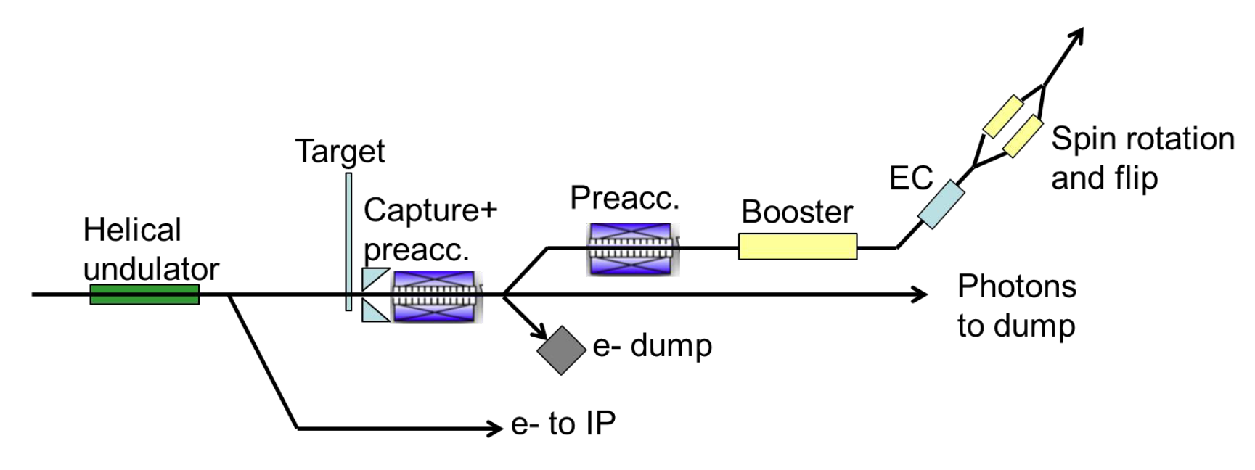
Polarised positron source:

Slide 26
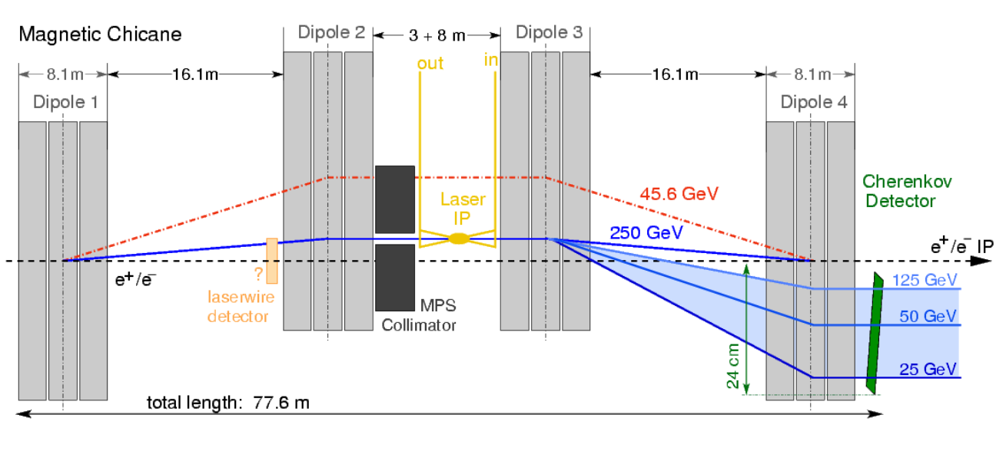
External polarisation measurement

Slide 27
Fit details
External Lumi & Pol constraints:
  ΔL/L = 3e-3
  For P = 0: ΔP = 2.5e-3, else: ΔP/P = 2.5e-3
Polarisation sharings for (P_{e-},P_{e+}):
  (80%,30%): -+ 45%, +- 45%, ++ 5%, -- 5%
  (80%,0%): -0 50%, +0 50%

